Slide 1
Bully-be-Gone
With all this technology, bullies should be a thing of the past now

Slide 2

Mission statement: Help people get rid of harassment, bullying and angry messages

Slide 3
The problem
In 2017, out of 4,500 school going US population, 74% of girls and 71% of boys faced bullying at some point.
This value has been increasing over the past couple of years.
2014 | 2015 | 2016 | 2017

Slide 4

The solution
Can we use existing technologies to battle this bullying epidemic?

Slide 5

Features
An anti-bullying extension accompanied by a parent portal
Parents have complete awareness of the bullying messages their kids receive

Slide 6
How it works
Step 3
Step 2
Step 1
Based on the result from the previous step, the extension censors the message and sends a logging request to our server
It checks whether a message is an angry/bully message by using the IBM API.
A chrome web-extension listens to your Facebook messages as you receive them

Slide 7
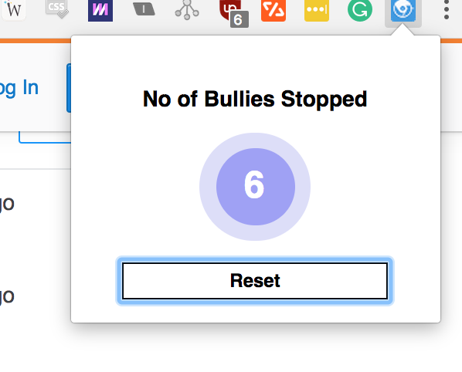
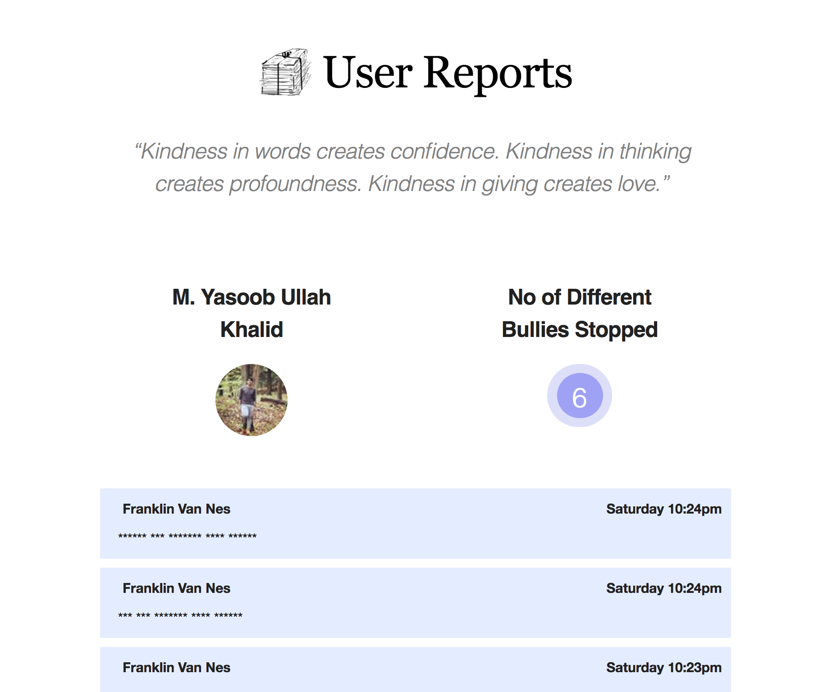
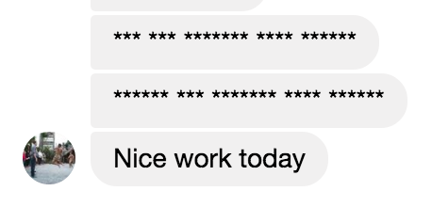
Different Screens
1. Bully Text is Detected
2. Bully Text is Blocked
3. Data is saved for parents

Slide 8
Thank You
Any Questions? This is still a work-in-progress with a couple of hickups but it works for most part. I would be more than happy to give a live demo.

